Slide 1
15 Critical Failure Factors (CFFs) in Business Development: Don’t Let This Happen to You
Lakehurst Small Business Roundtable
(LKE-SBR)
Eric Gregory
Senior Vice President
Business Winning-East
March 23, 2015
Notes:
Image does not show in workbook. Workshop title display only.
Note: Instructor should fill in name, APMP accreditation, and title.
###

Slide 2
Welcome!
Adventure: The Hunt
Excitement: The Challenge
Thrills: The Ride
Chills: The Anticipation
Dizziness: The Adrenaline
Fun: The Win

Slide 3
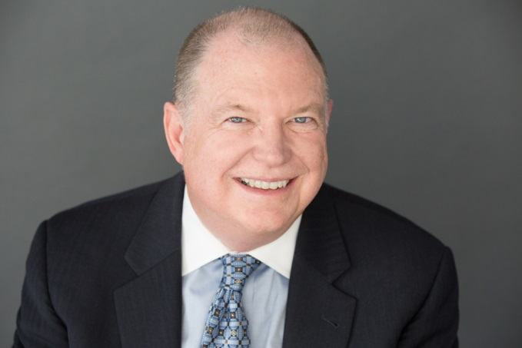
Background—Your Advocate
38 years of capture, proposal, and business development experience
Led CACI’s proposal operations for 14 years
CACI grew from $325M to $3.8B during tenure
Capture major new and recompete business
Delivered results continuously
Developed group of more than 100 capture and proposal professionals
Lead all of Shipley East consulting
Managed major proposals and capture efforts for Bendix, Martin Marietta, Litton, Hughes Aircraft, and CACI
Developed process and procedures for major proposal operations
APMP certified Professional (CPP APMP Fellow)

Slide 4
Objectives
Gain perspective
Achieve motivation
Understand criticality of success through BD performance. Create a culture of winning
Develop confidence you can succeed

Slide 5

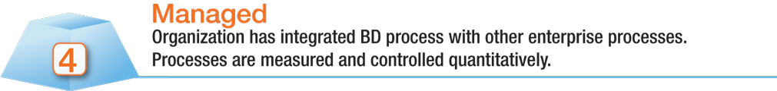


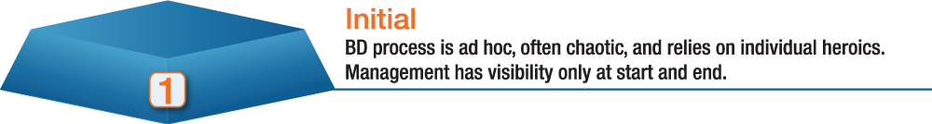
Good Business Development Targets Excellence
Tough to Achieve
BD CMM
Target
Standard
Capability Maturity Model, CMM, and CMMI are registered in the U.S. Patent and Trademark Offices. CMM Integration and SCAMPI are service marks of Carnegie Mellon University.

Slide 6
Simple Things Wins Depend On
Customer Knowledge
Competitor Knowledge
Self Knowledge

Slide 7
Critical Success Factor
Critical success factor (CSF) is the term for an element that is necessary for an organization or project to achieve its mission. It is a critical factor or activity required for ensuring the success of a company or an organization.

Slide 8
Critical Failure Factor
Critical failure factor (CFF) is the term for an element that if not accomplished places all critical success factors in immediate jeopardy.

Slide 9

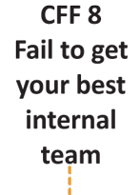
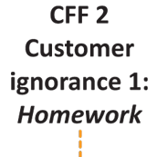
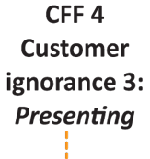
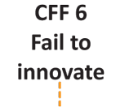
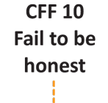
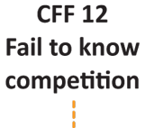
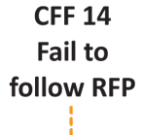
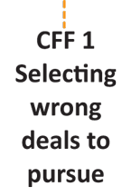
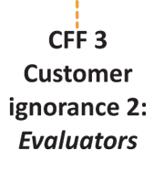
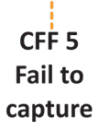
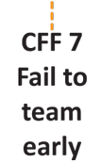
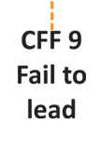
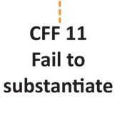
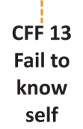
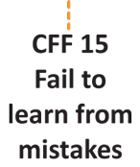
15 CFFs: Don’t Let This Happen to You

Slide 10
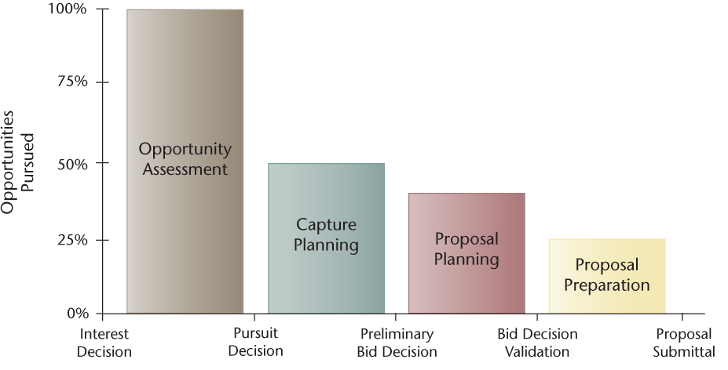
CFF 1 Selecting wrong deals to pursue:
It all begins here
First order BD health metric: How many no bids are you making?

Slide 11
Decision Gate Questions
Who have you talked to?
When and where did you talk to them?
What did you learn?
Have you read key customer documents?
What is their acquisition strategy? Can we shape it?
Who will be the decision makers?
What are the key issues the procurement will turn on?
What is our solution approach tied to their mission and issues?
What is the PTW? Can we get there?
Who is competing and what will their offer be?
What will it cost to win?
Do we have the people to win?
What are the 5 critical actions we have to take to improve Pwin?
Is it real?
Can we win?
Do we want to?
Customer knowledge
Competitor knowledge
Self knowledge

Slide 12
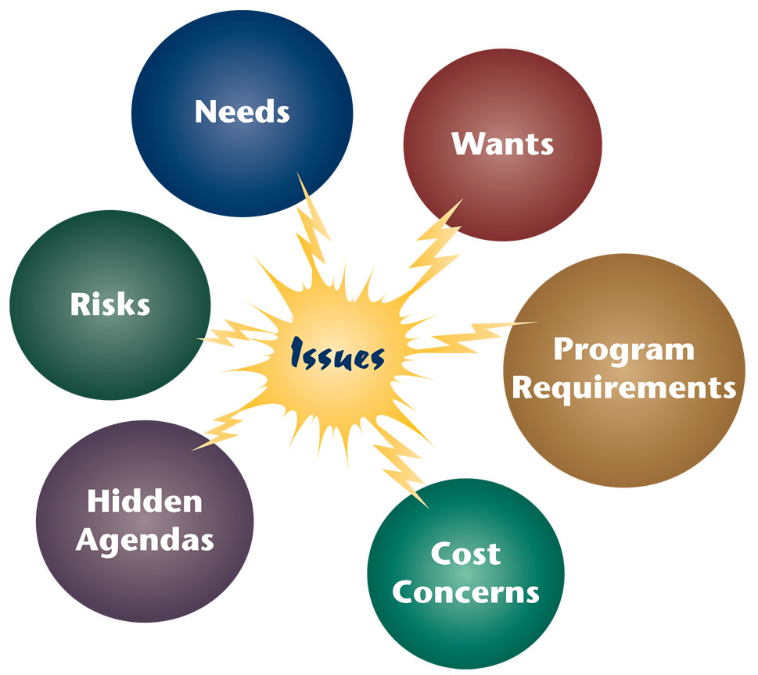
CFF 2 Customer Ignorance 1: Do your homework
Know the customer: mission, issues, needs, critical success factors
Strategic plans
Operational plans
Mission Needs Statements
Articles
Advanced Planning Briefings to Industry
GAO Reports

Slide 13
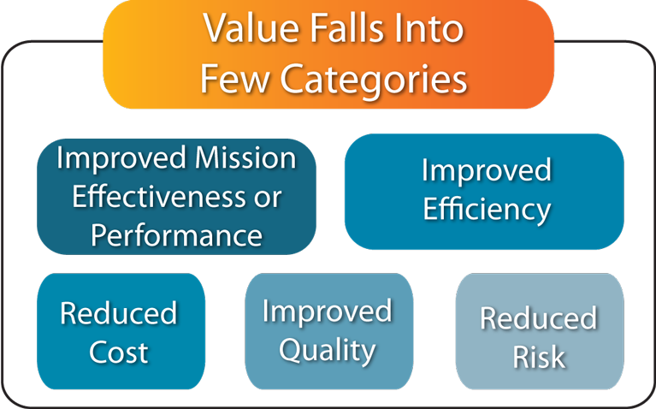
CFF 3 Customer Ignorance 2: Visit evaluators
Contact reports
Individual profiles
Hot button cheat sheets
Likes/dislikes
Favorites/disfavor
Characteristics
  Risk averse
  Leader
  Follower
  Innovator
Who will be evaluating the proposal? Focus on them.
Know what is important and design win strategy around it.

Slide 14

CFF 4 Customer Ignorance 3: Don’t present, converse
The continuous exchange of meaningful information indicates progression of Pwin.
Know Mission, Vision, Objectives
Work to make them successful
Build constructive relationships
Elicit issues, concerns, risks, identify key angles
Share potential solutions, strategies, goals, outcomes, risks
Solicit input
Create team approach
Gain trust

Slide 15
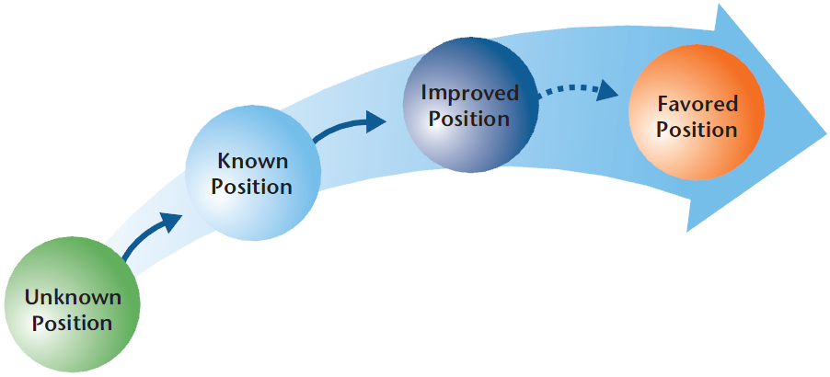
CFF 5 Fail to Capture
Capture depends on specific actions designed to increase Pwin
Customer
Influenced
Company
Positioned
to Bid and Win
Customer,
Opportunity,
and Competitors
Researched
Opportunity
Discovered

Slide 16
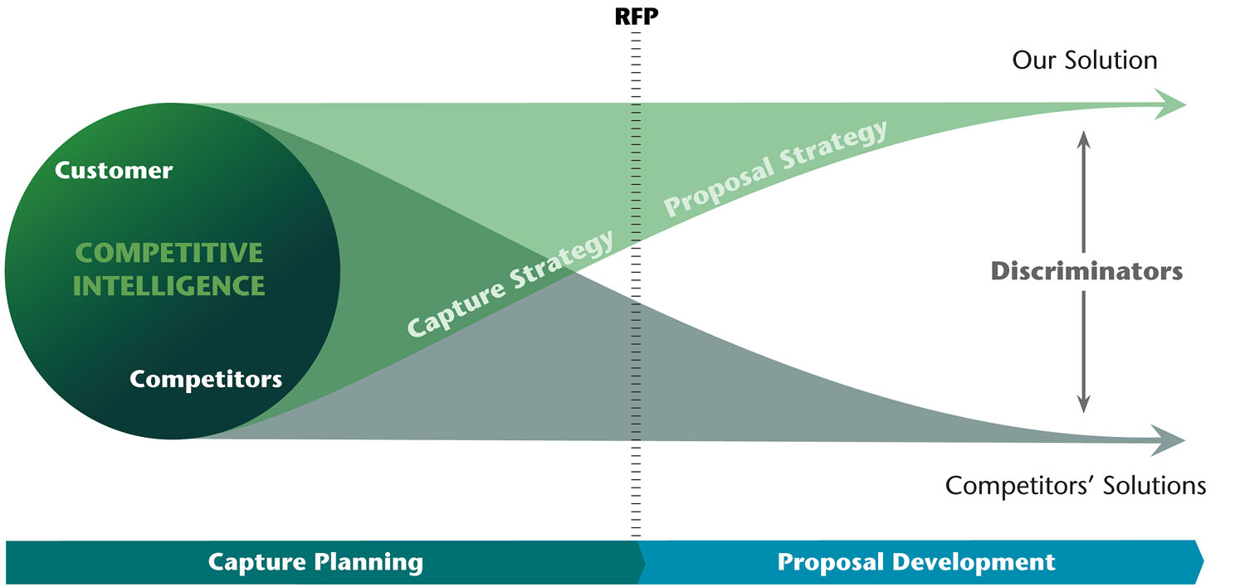
CFF 6 Fail to Innovate
New twist on proven approach is innovation with the right benefits.
Innovation leads to differentiation and discrimination

Slide 17
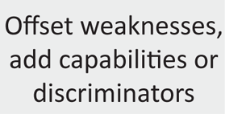
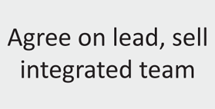
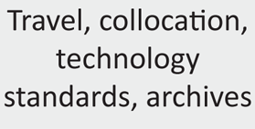
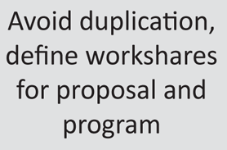
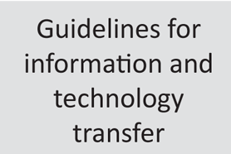
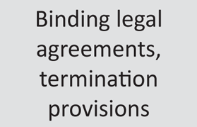
CFF 7 Fail to Team Early
Early teaming key to selling team and gaining customer confidence

Slide 18

CFF 8 Fail to Get Your Best Internal Team
B and C teamers don’t win World Series
A Successful Capture Leader….
Embraces process and discipline
Creates and manages to a Blue Teamed Capture Plan
Sets high expectations for the Capture Team
Focuses every minute on increasing Pwin
Leads by example
Helps the Team succeed
Makes the right actions happen
Works always from a position of knowledge
Recommends a No Bid when necessary

Slide 19
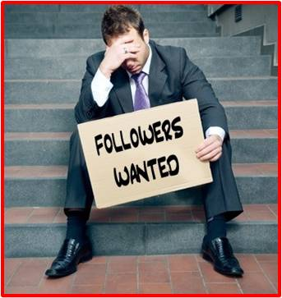
CFF 8 Fail to Get Your Best Internal Team
B and C teamers don’t win World Series
The Essential Follower….
Critical to success. Team focused
Follows the process and points out where it needs to be followed better
Sets the example for other capture and proposal team members
Skilled in executing capture actions to increase Pwin
Deferential but firm
Recommends but leaves decisions to the Capture Manager

Slide 20
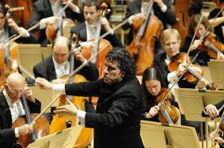
CFF 9 Fail to Lead: Executive Involvement
Executive management abandons process designed to propel leadership capability
Executive management does not attend kickoffs or color team reviews
Capture Team resigns themselves to defeat through discouragement, frustration and detachment.
The Capture Team never
creates the winning melody
and harmony. No sweet
music to the customer’s ears.

Slide 21

Avoiding Failure to Lead
Clear executive participation
Executive team gets regular progress updates
Executive team contributes ideas but does not seek to control the effort
At the kickoff appears confidence, discipline, knowledge, capability, inspiration, commitment, and effective planning. The Team absorbs it all.

Slide 22

CFF 10 Fail to Be Honest
Customer Knowledge
We don’t admit what we don’t know
and fail to transform performance
issues into strengths.
Competitor Knowledge
Self Knowledge

Slide 23
CFF 11 Fail to Substantiate
Win with facts and data
Unsubstantiated claims = Kiss of death
Identify critical data needs early in process
Collect, analyze, and prepare data to support win strategy
Test data, personnel data, hiring data (speed), performance data (award fees), facilities data, and other data tailored to customer hot buttons, issues, and driving requirements
No hype…just the facts
Bullets, Graphs, bar charts, pie charts, tables, and labeled graphics

Slide 24
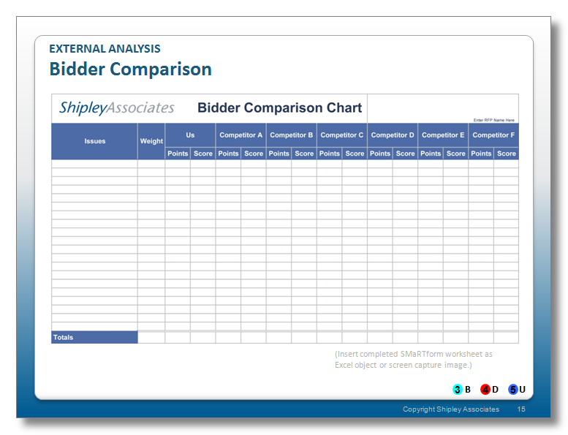
CFF 12 Fail to Know Competition
The enemy gets a vote

Slide 25
CFF 13 Fail to Know Self
Everybody else knows your weaknesses from the customer’s perspective.

Slide 26
CFF 14 Fail to Follow RFP
I know better syndrome
The Seven C’s of Effective Proposals
Compliant
Customer-focused
Clear
Compelling
Concise
Creative
Credible

Slide 27
CFF 15 Fail to Learn From Mistakes
Lessons catalogued must be learned
Post submittal
Post award
Facilitated
Scheduled
Recorded
Analyzed
Recommendations made, used, and available

Slide 28
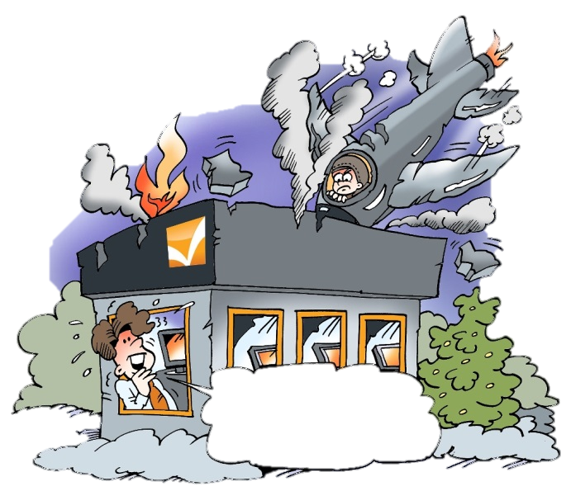


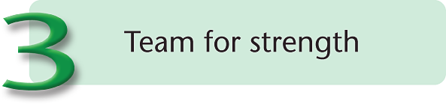
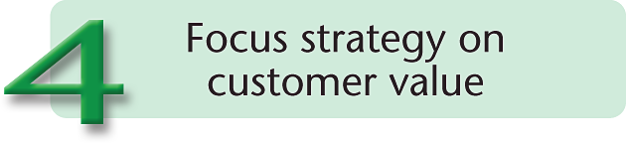
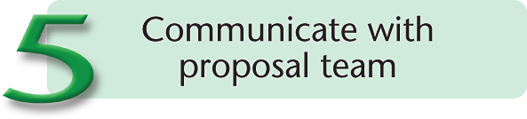
The Wrap Up: What to Do When Time Is Short
You could have
avoided this!
Be Compliant and Responsive
Notes:
Introductory Text:
As lead time shrinks, opportunities to influence the customer naturally decline. No matter how little time is available, consider the essentials of capture management shown in Figure 51.
Action Caption:
Figure 52. When Time Is Short. Always know your real customer. Analyze your competitive position as well as you can, even if the RFP has already been published. Team to add strength and discriminate your offer. Focus on the value you can bring to the customer rather than your own organization's needs. And always, always communicate what you've learned to the proposal team so they do not have to work in an information vacuum.
Narration:
Now that we've covered all the material I planned, I want to spend the last couple minutes together talking about what to do when time is short. Things may be moving quickly because the customer has an emergency situation. More likely, your organization has arrived late at the dance.
Perhaps a no-interest/no-pursuit/no-bid decision is the wisest course, but management is determined to go after an opportunity. In some cases, there may be extenuating circumstances that make our typical advice invalid. Maybe the situation is literally bid or go home. In those cases, you're not helping anyone by climbing up on your Shipley soapbox and preaching that you should have started sooner. Take the skills you've learned in this workshop and do the very best job you can with the resources you have in the time available.
Number 1: Figure out who the customer really is. Learn the organization and be able to map it from cabinet secretary down to purchasing office. Understand who the contracting officer is and how the contracting office relates to the rest of the acquisition team. (There may be a central contracting office, possibly in a different location.)
Number 2: Prepare a bidder comparison chart. Even if the RFP has already been released, collect the smartest people you can find who know the customer and likely competitors. Do the best job you can of listing the hot buttons and rating the competitors. Be honest, and then spend some time trying to understand what the chart tells you. Make several passes. In the worst case, this can be done in a few hours. If you're not willing to invest that much time, give up, because the result is probably going to embarrass you.
Number 3: Team for strength. Don't team with a competitor to take them off the street. You generally wind up looking no stronger to the customer.
Number 4: Focus strategy on customer value. Forget about yourself. Ask yourself what you provide the customer that will be unique. Better yet, ask the customer!
Number 5: Communicate with the proposal team. Don't waste your efforts or theirs by letting them start from scratch.
###

Slide 29

Thank You for Attending
Eric Gregory, CPP APMP Fellow
Senior Vice President, Business Winning-East
Shipley Associates
Mobile: 703 919 2340 Office: 703 690 9422
Fax: 703 690 7839
egregory@shipleywins.com
Check Out the Free Webinar Series

